Slide 1
Fun with functional programming using Elm
Learn the paradigm of functional programming in a fun way by creating web apps in a pure functional language - Elm

Slide 2

Today
Why learn this way?
Why choose functional programming?
What is functional programming?
Introduction to the Elm language

Slide 3

About me
40 years as a developer
Startup during 2019 using Elm

Slide 4

Why learn this way?
Learning should be fun
Interacting with things on screen is fun
Friendly and helpful compiler is fun
Use a pure language to get it right
Avoid multi-paradigm

Slide 5
Programming languages

Slide 7
What is functional programming?
Aspect | Functional | Object oriented
Main abstraction | Function | Object
Language class | Declarative | Imperative
State | Immutable | Mutable
Function is the main abstraction
Immutable state
Declarative

Slide 8
Why choose functional programming?
Easy to understand code
No need to consider rest of system
Cache result
Parallel execution of independent functions
Here may be dragons

Slide 9
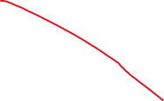
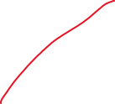
What is a pure function?
print(String s)
random()
dateTime()
add(Integer x, Integer y)
toHtml(Model m)
No side effects
Always the same result, given same arguments

Slide 10
But wait… no side effects?
Anything useful has side effects, instead let’s talk about:
Actions
Depends on when they are called. E.g. print().
Calculations
Convert input to output (pure). E.g. sum() .
Data
Facts “{”playerId”:“dfedb43e-7194-4348-a615-9e09744b1b51”}”
Functional thinking

Slide 11
How does that help?
Actions
depends on number of calls, timing and input
Calculations
depends on input only
Here we want as much of as possible of our code
Notes:
Easier to test. Easier to understand. Less bugs.

Slide 12
Send players their stats
Actions
Get game rounds
Example::
Game rounds
Get players
Players
Getting data are actions
You want to minimize logic here
Calculating stats is the workhorse
It depends only on input – easier to test
Calculations
Calculate stats
Email
Actions
Send email
Notes:
Istället för att skicka samtidigt som man läser upp data. Svårt att få garantier att det blir korrekt.

Slide 13

Introduction to the Elm language
Pure functional language
Strong but nice type system
Dedicated to the web
Compiles to JavaScript

Slide 14
Elm’s selling points
No Runtime Exceptions
Great Performance
Enforced Semantic Versioning
Small Assets
JavaScript Interop

Slide 15


The nice clean world of Elm
Safe
REST
JavaScript
Port
JSON Decode/Encode
Per Lundholm

Slide 16
Elm has guard rails
Types!
No null value
An if has an else
Modules for isolation
A switch handles every case
Friendly and helpful compiler

Slide 17
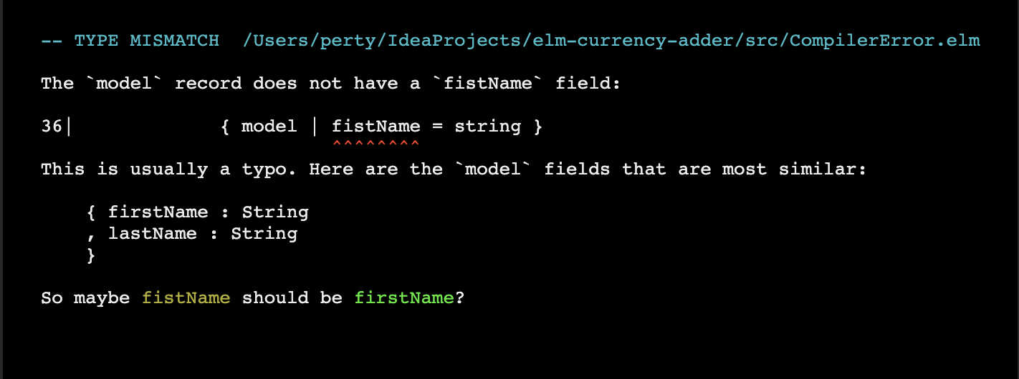
Friendly compiler

Slide 18
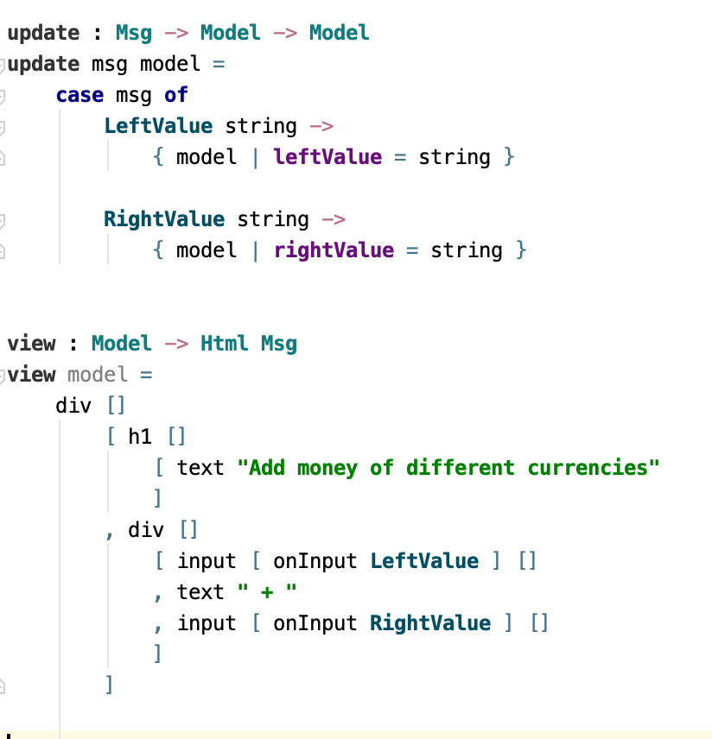
What does Elm look like?
A bit like Haskell
A function has an optional type declaration
The definition is an expression

Slide 19
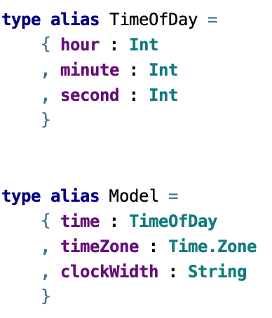
Elm types
Records
Records
Custom types
Phantom types

Slide 20
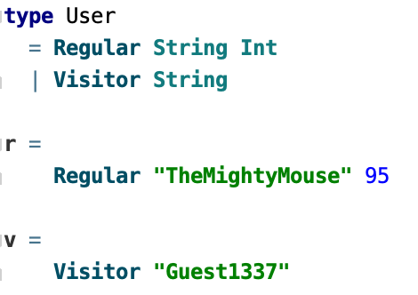
Elm types
Custom
Records
Custom types
Phantom types

Slide 21
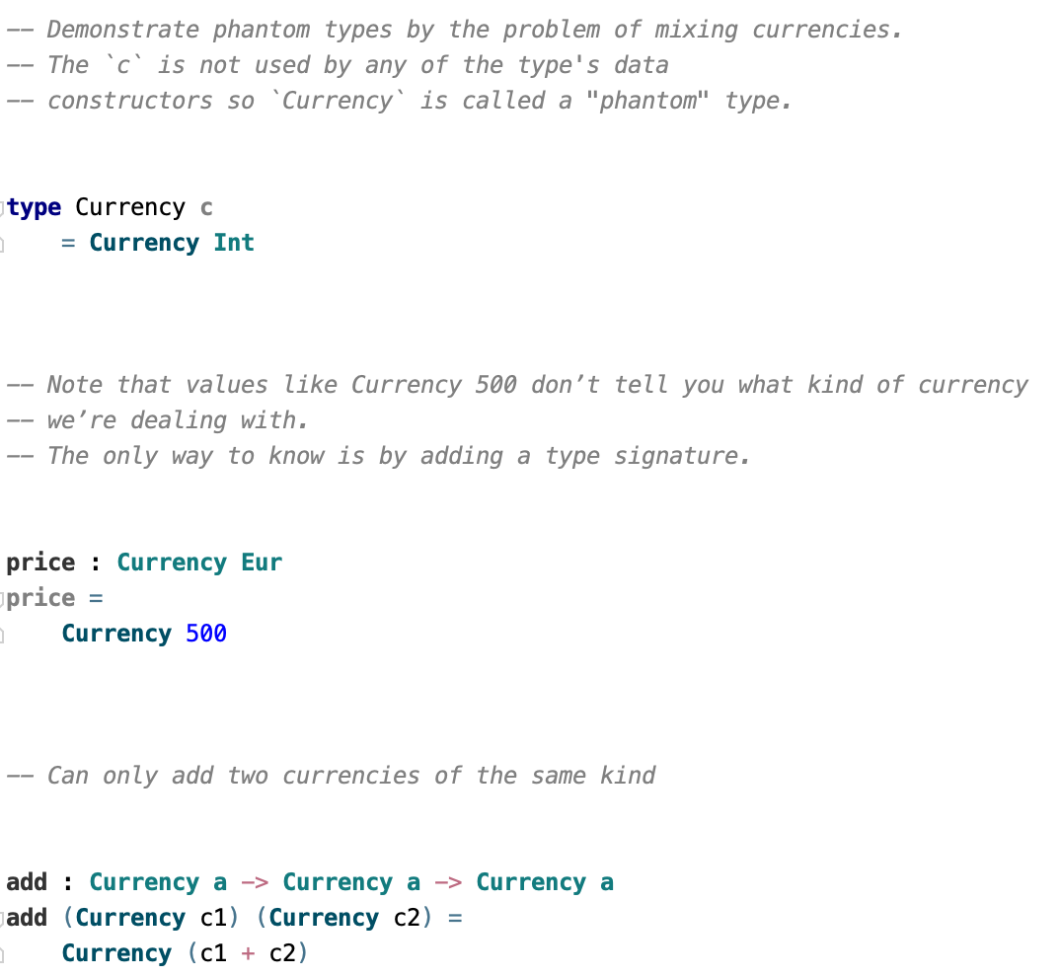
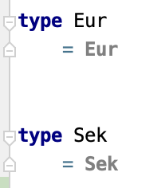
Elm types
Phantom
Records
Custom types
Phantom types

Slide 22
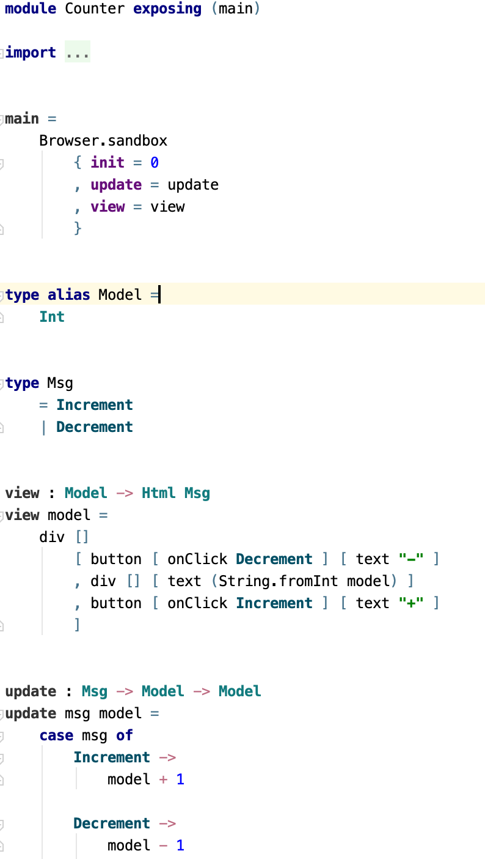
The Elm Architecture
Model = application state
View = function of the current state
Update = function of current state and a Message

Slide 23
The Elm Architecture
The view takes the model and creates HTML (1,2)
User activity emits a Message (3,4)
Runtime pass Message and Model to Update (5)
Update creates a new model and initiates side effects (e.g. REST call) (6,7,8)

Slide 24
Let’s code!

Slide 25
Use elm-init
mkdir my-elm-project
cd my-elm-project
elm init
The directory gets a starting elm.json and an empty src folder.

Slide 26
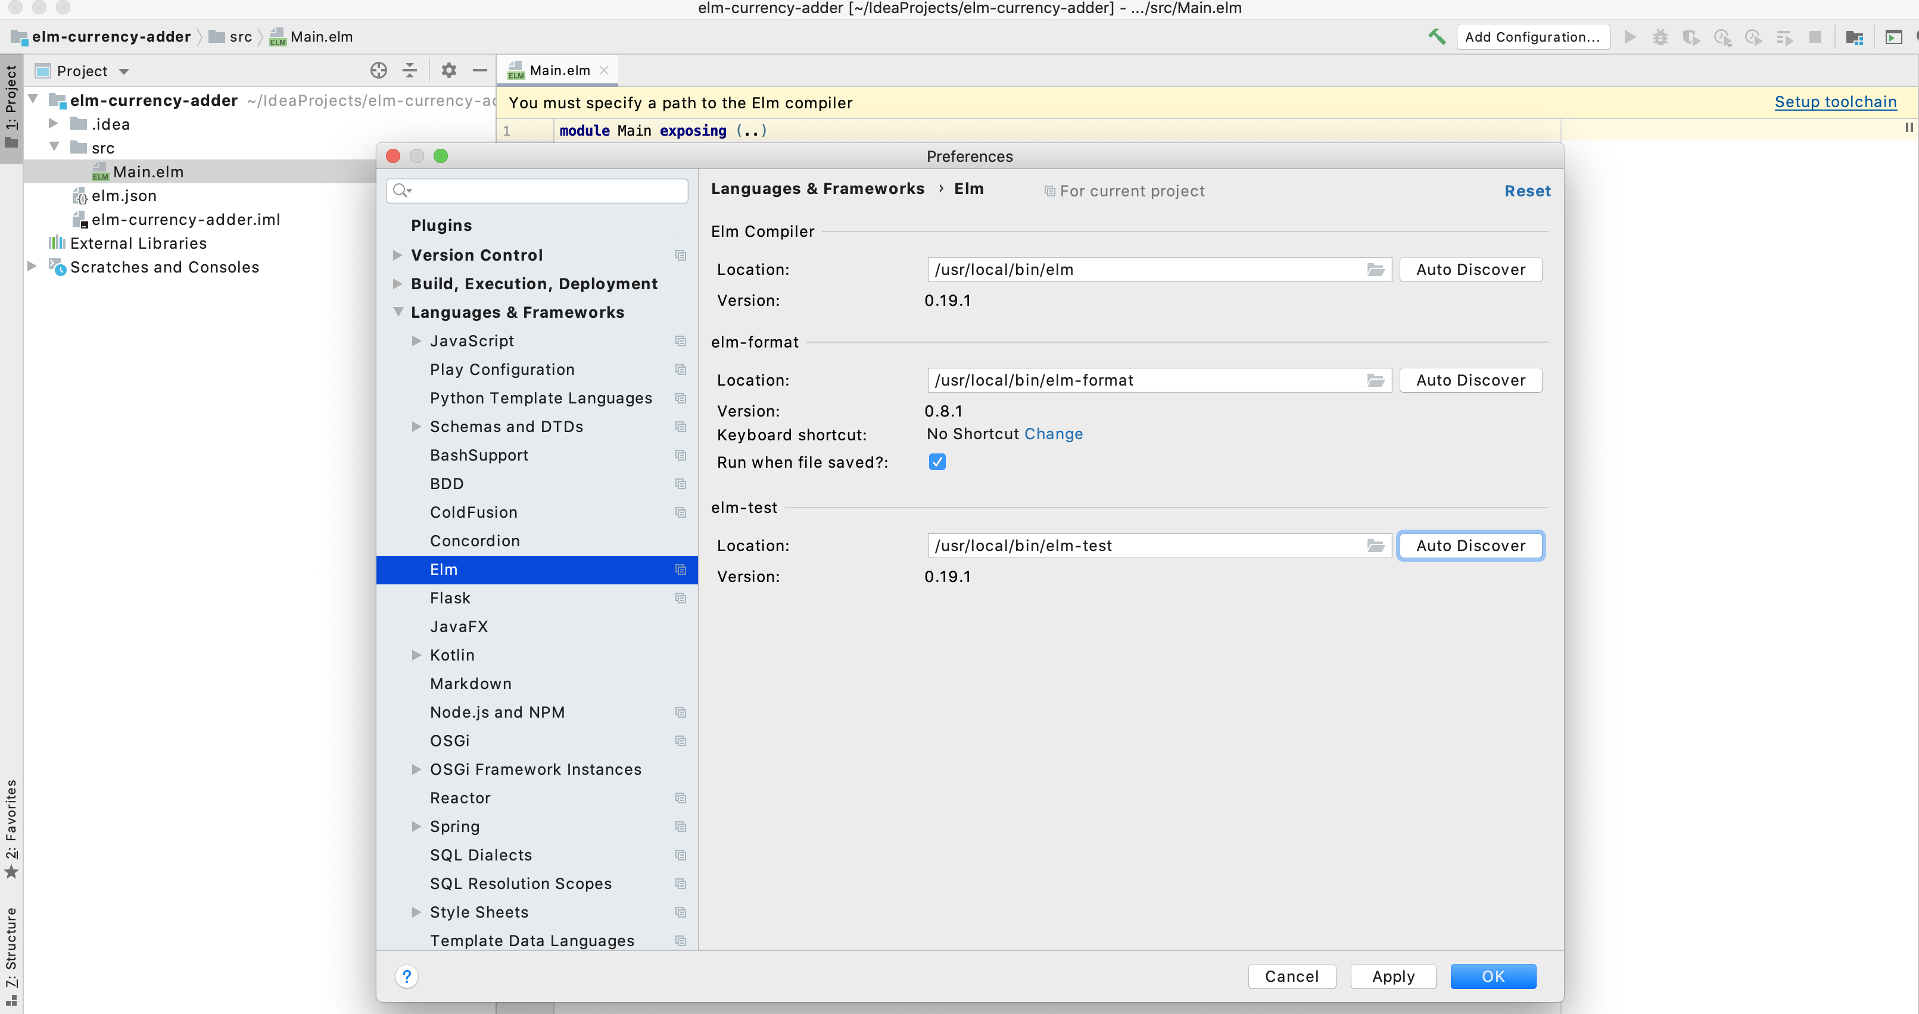

Slide 27
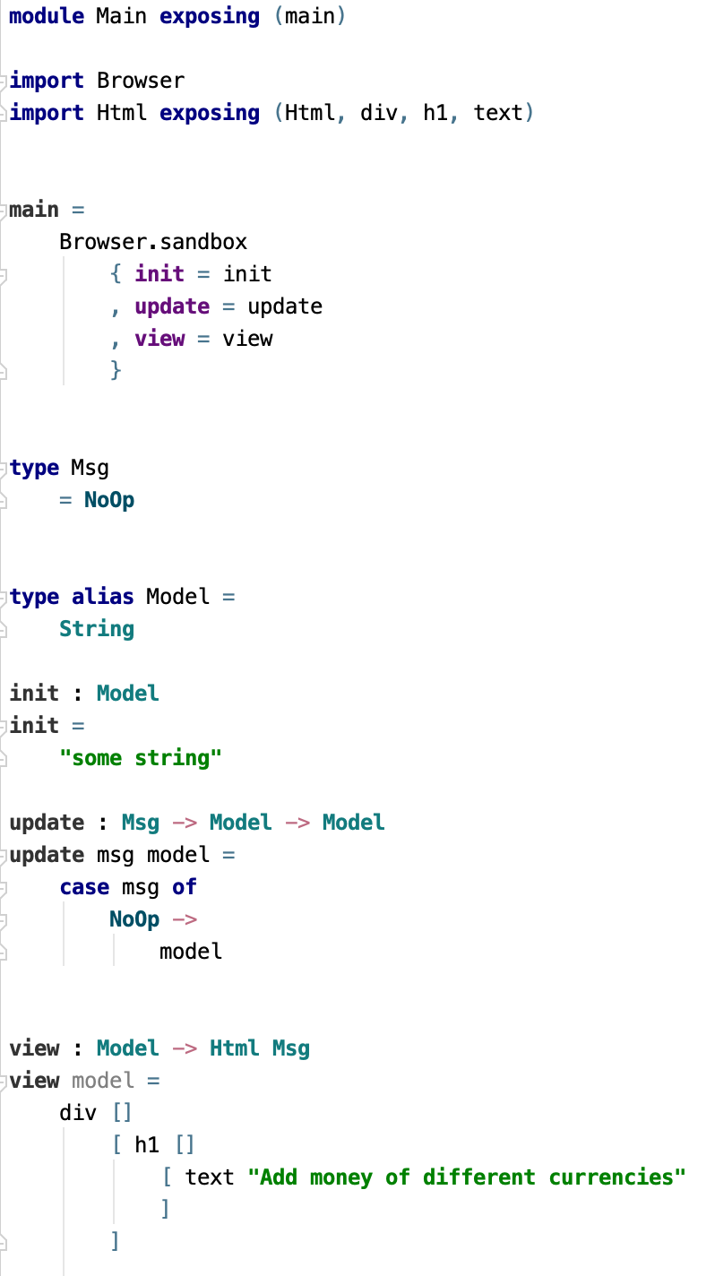
Hello world

Slide 28
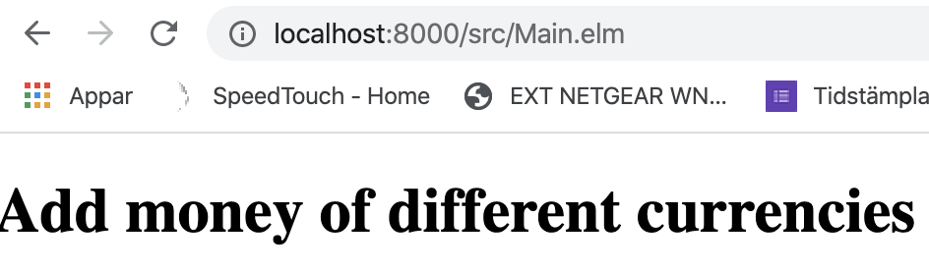
> elm reactor Go to http://localhost:8000 to see your project dashboard.
Elm reactor is ok but there is also elm-live

Slide 29
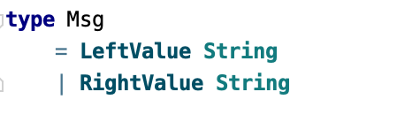
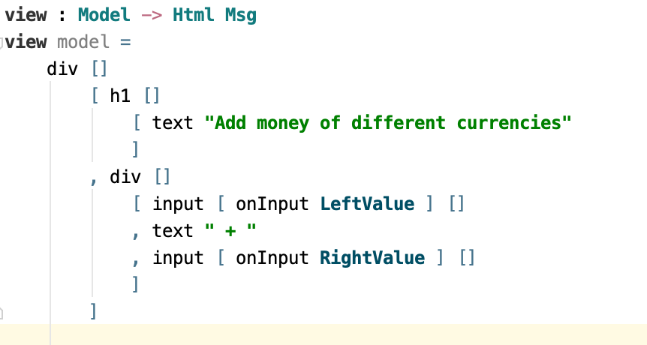
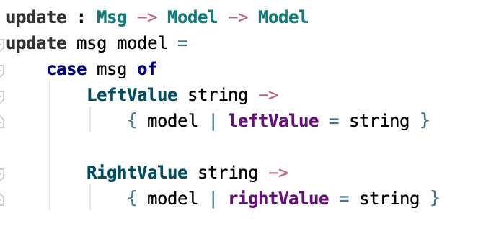
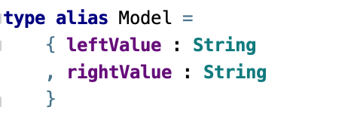
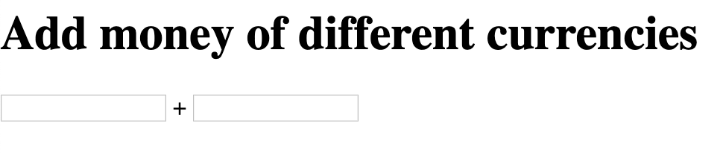
Let’s add input
This means “compiler error”.
Notes:
We add some input fields. Input fields takes a message that carry a string. When we add that to the view, we must change the Msg type. When we change that, we must change the update function to handle the new messages. We like to store the new value of the input field. We wish to store it in the model. So we must change the Model type. All these things are discovered at compile time.

Slide 30
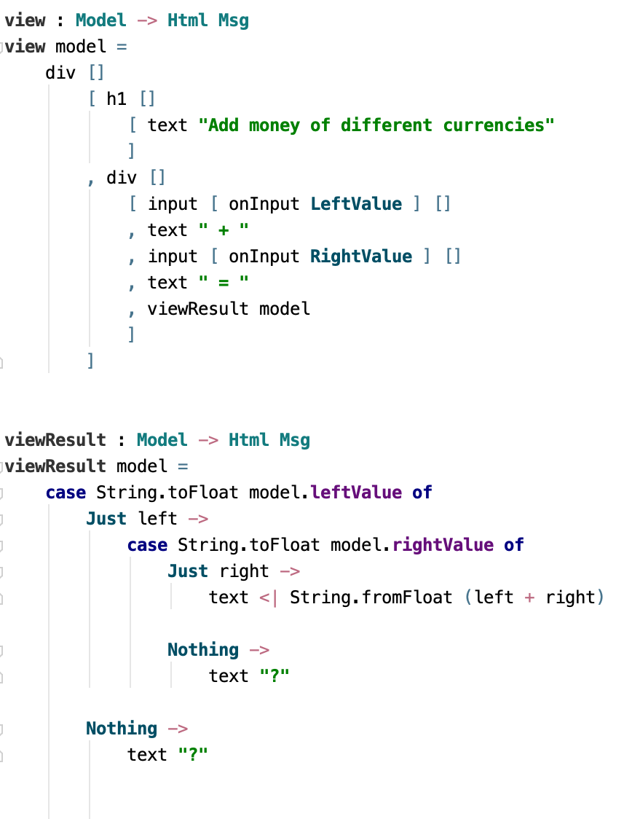
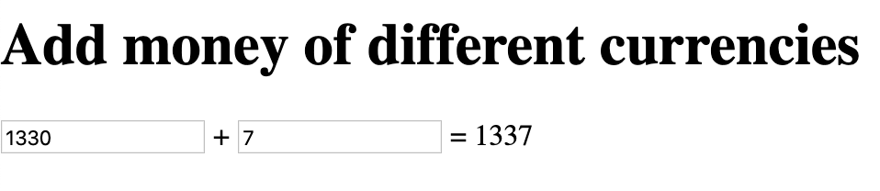

Let’s show the result

Slide 31
Let’s make a table with currencies Note the use of map to divide and conquer the problem

Slide 32
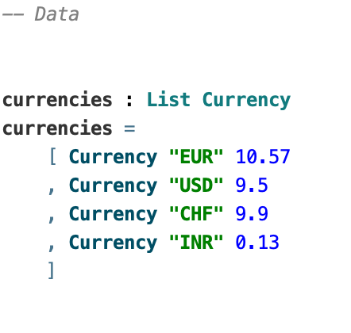
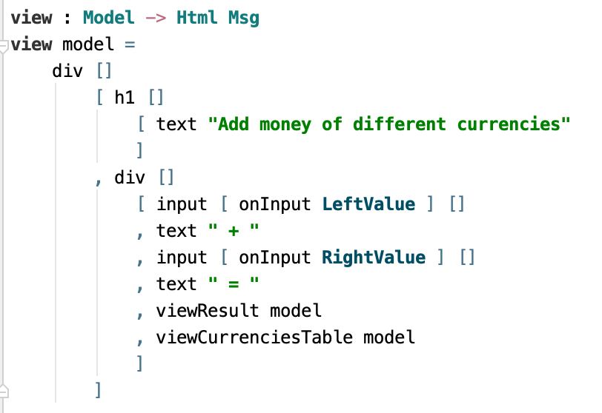
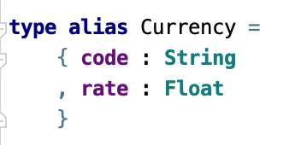
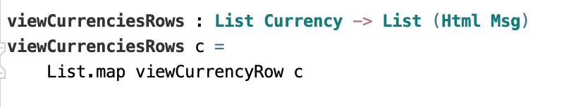
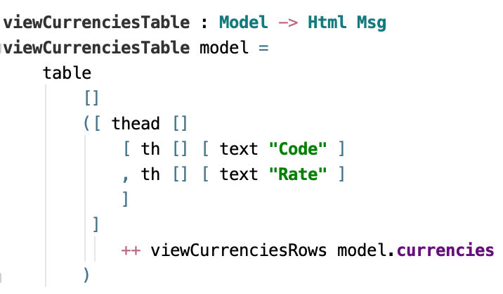
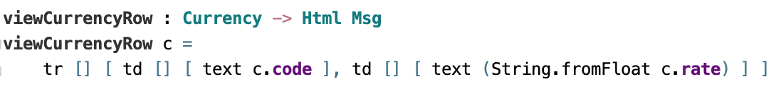


Slide 33
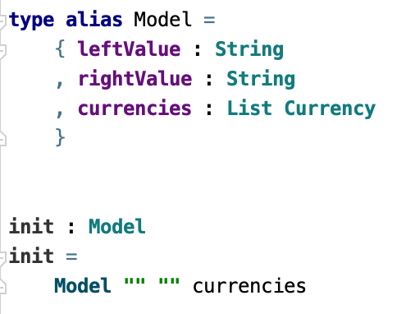
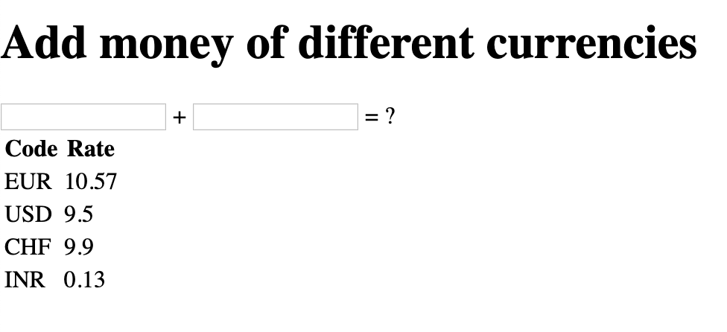

Slide 34
Please stand by
We will continue after this message from the HTML world.

Slide 35
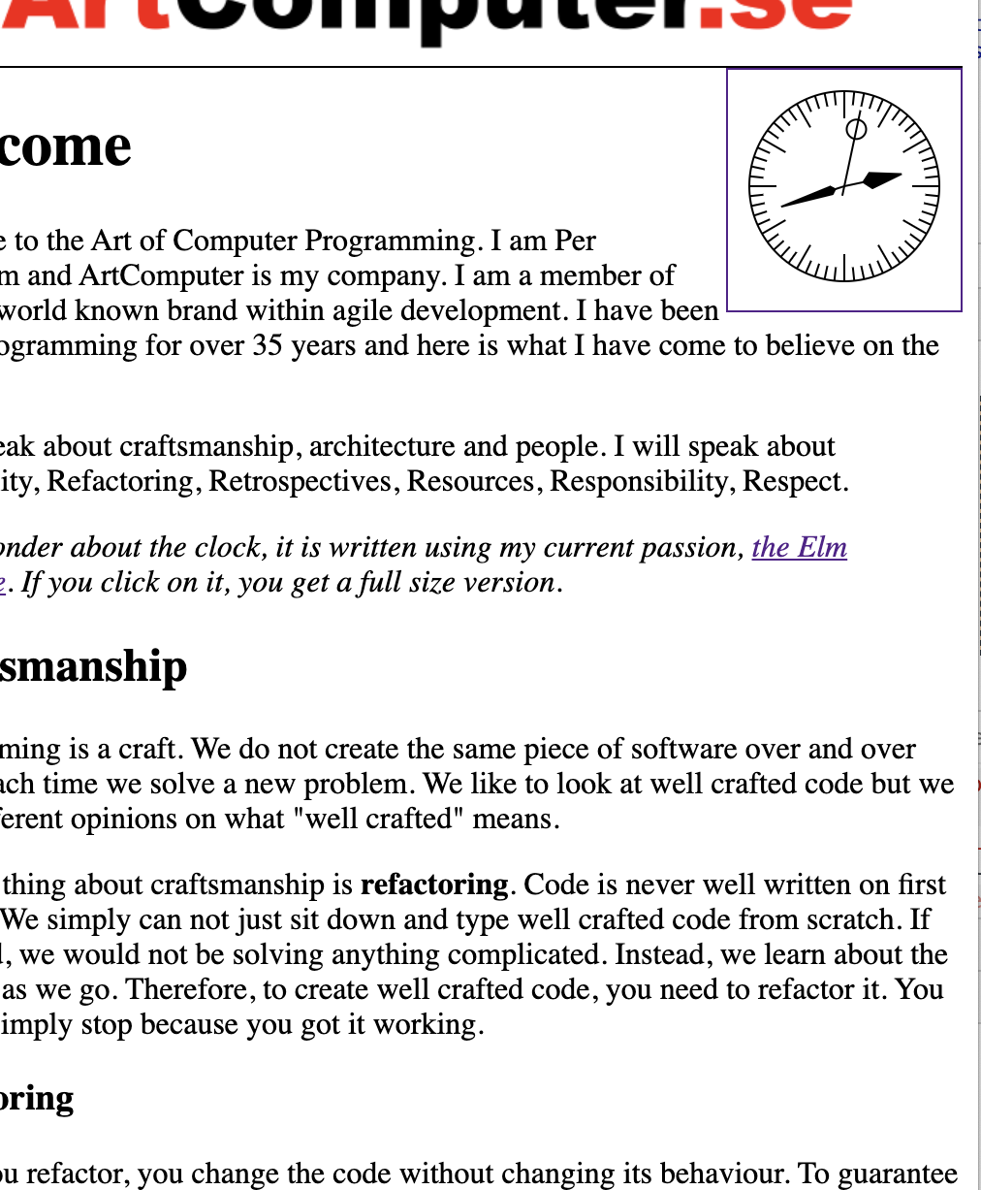
Place on page
Place the Elm program in a tag
Strategy for replacing legacy UI

Slide 36
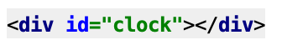
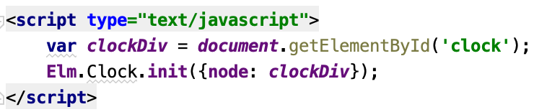
elm make src/Clock.elm --output=elm.js

Slide 37
Continuing the coding

Slide 38
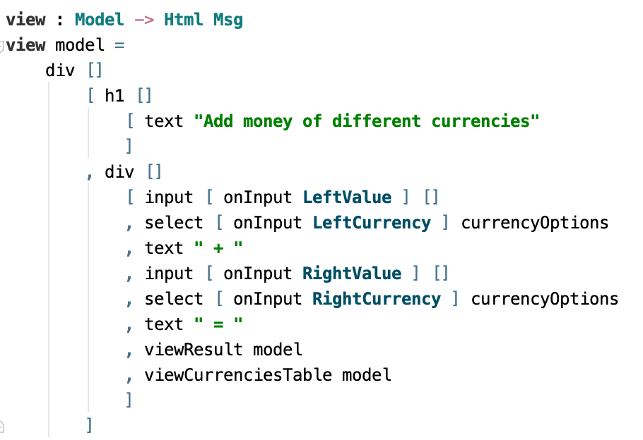
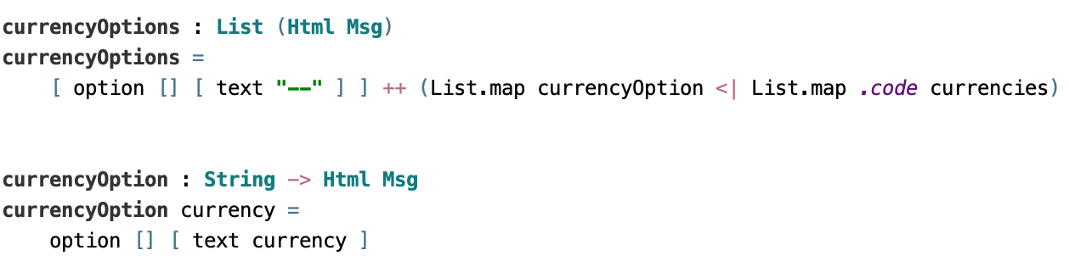
Select currencies

Slide 39
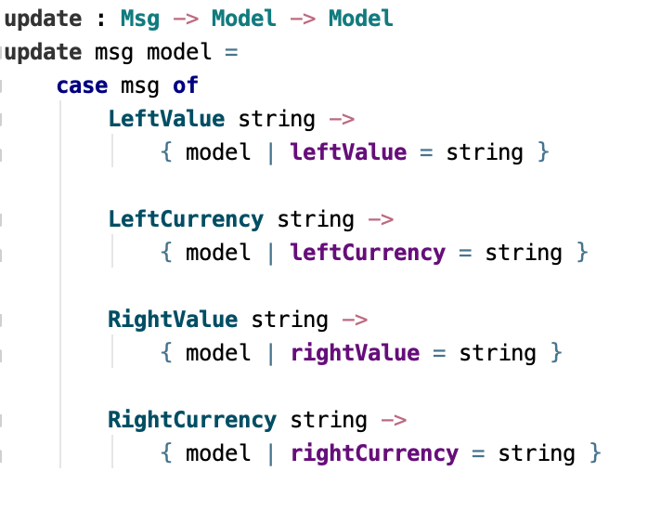
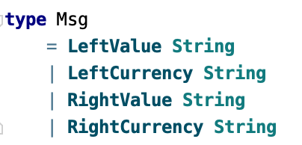
Select currencies

Slide 40
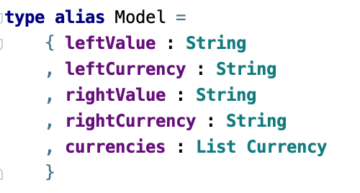
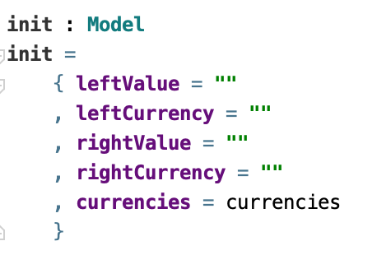
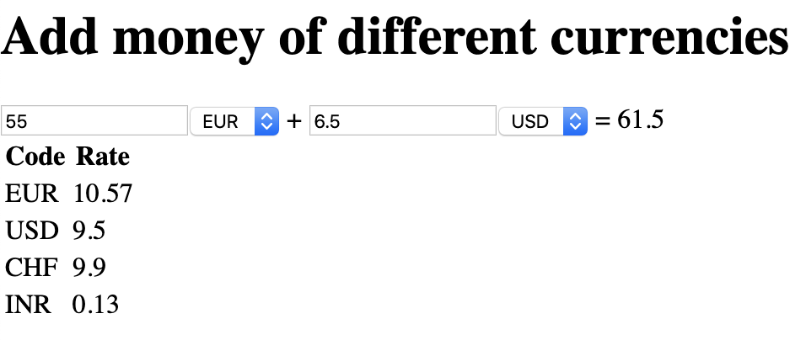
Select currencies

Slide 41
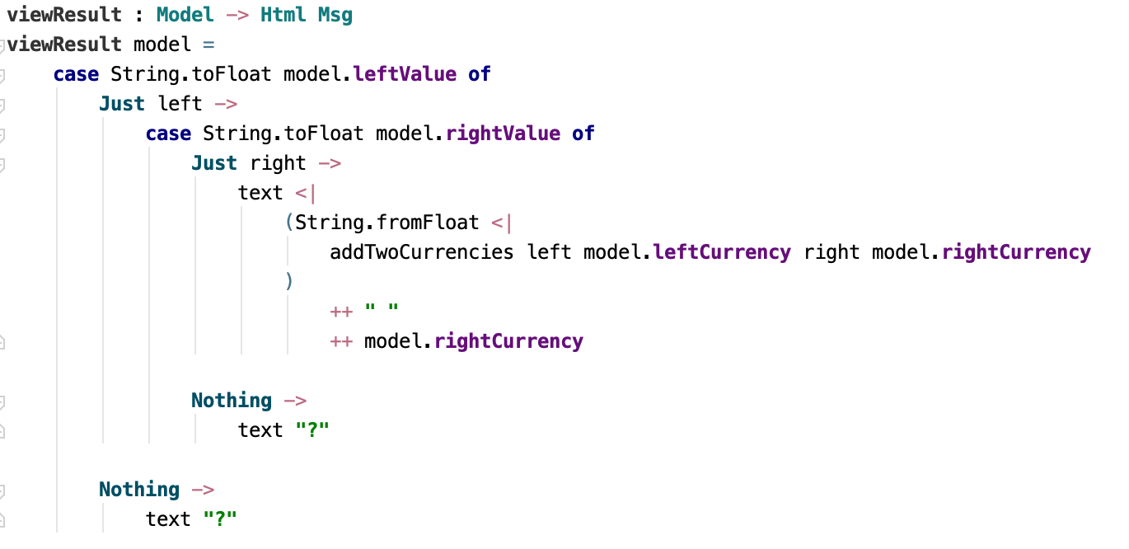
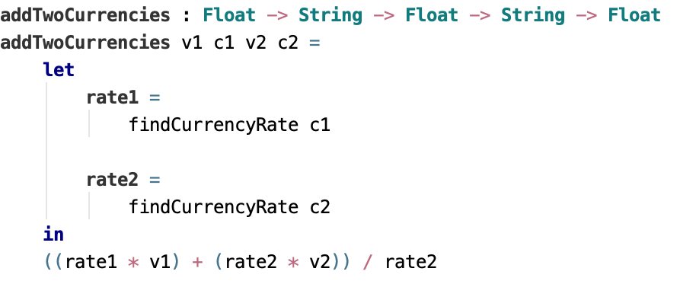
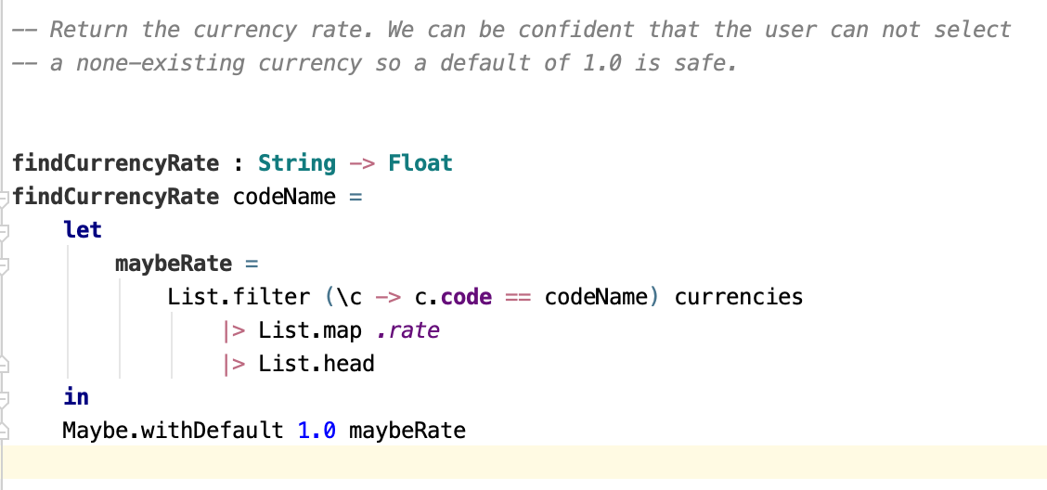
Use currencies. Add two amounts of different currencies. Result in 2nd currency.

Slide 42
Improve this code
There are too many primitives, Float and String everywhere. We should have domain modelled types.
There is no way of telling which field is problematic. We should give the user feedback, e.g. marking field that is not correct. Change the attributes for that field to make it visually apparent.

Slide 43
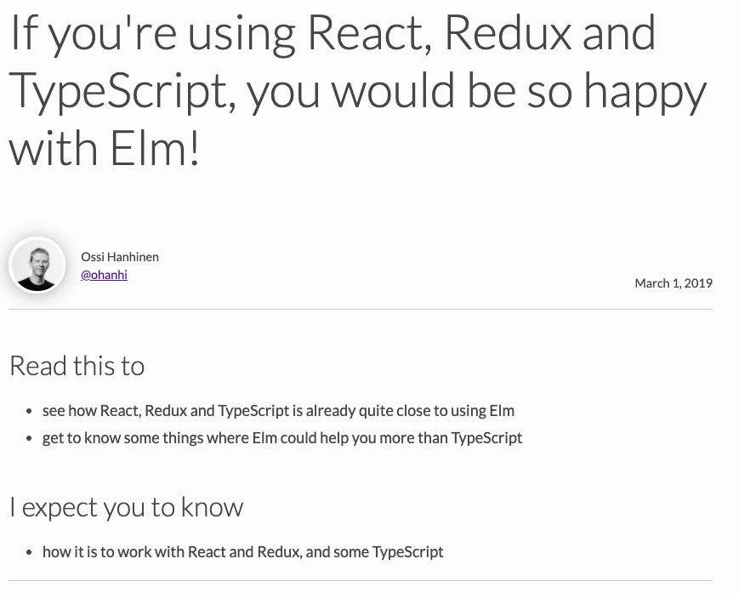
Comparing with React
https://ohanhi.com/react-typescript-vs-elm.html

Slide 44
Elm – Redux translation
Concept | Elm | Redux
Application state | Model | State
Application events | Message | Action
Function that transforms the state | Update | Reducer

Slide 45
Thank you!
Ask me about Elm
https://github.com/perty/elm-currency-adder

